Slide 1
Suburb Selection in Downtown Toronto
Coursera Capstone Project

Slide 2
Introduction and Background
Downtown Toronto is the main central business district of Toronto, Ontario, Canada. There are approximately 600 retail stores, 150 bars and restaurants and 7 hotels. In recent years the area has been experiencing artistic changes including opening live theatres and a movie complex. Lots of people are migrating to Canada especially in recent years.
The purpose of this project is to help people make better decisions when choosing a neighbourhood to stay in Downtown Toronto. This includes facilities such as shopping centres, supermarkets, cafes etc as well as public transport, school ratings if they have kids.
This project aims to select top 5 suburbs for students based on the factors mentioned above.

Slide 3
Data
1. Toronto neighbourhood data from wikipedia
- including postal code, borough and neighbourhood.
- https://en.wikipedia.org/wiki/List_of_postal_codes_of_Canada:_M
2. Geospatial data
- Longtitude and Latitude data for each neighbourhood based on its postal code
- http://cocl.us/Geospatial_data
3. Foursquare API data
- Foursquare location information is needed which includes different venues and events.
- selected radius is 200 meters, top 20 venues

Slide 4
Methodology
The first step is to prepare and clean the neighbourhood data from the Wikipedia page. Canada postal codes, borough and neighbourhood are detailed on the website. Those with Borough as “Not assigned” has been removed.
Geocodes detailing each postal code’s respective latitude and longitude have been extracted from the csv file. The neighbourhood data from the Wikipedia page and geocoding data have been combined.
Based on Downtown Toronto’s coordinates, a map of Downtown was created.

Slide 5
Methodology
Using Foursquare, we were able to extract venues around the same neighbourhood, within a set radius. Detailed summary table for venues are obtained. We have mainly focused on venue name and its coordinates. Top 5 venues from each borough is shown.
We then determined the most common venues within each neighbourhood. Note the most common venues in each neighbourhood is quite different.

Slide 6
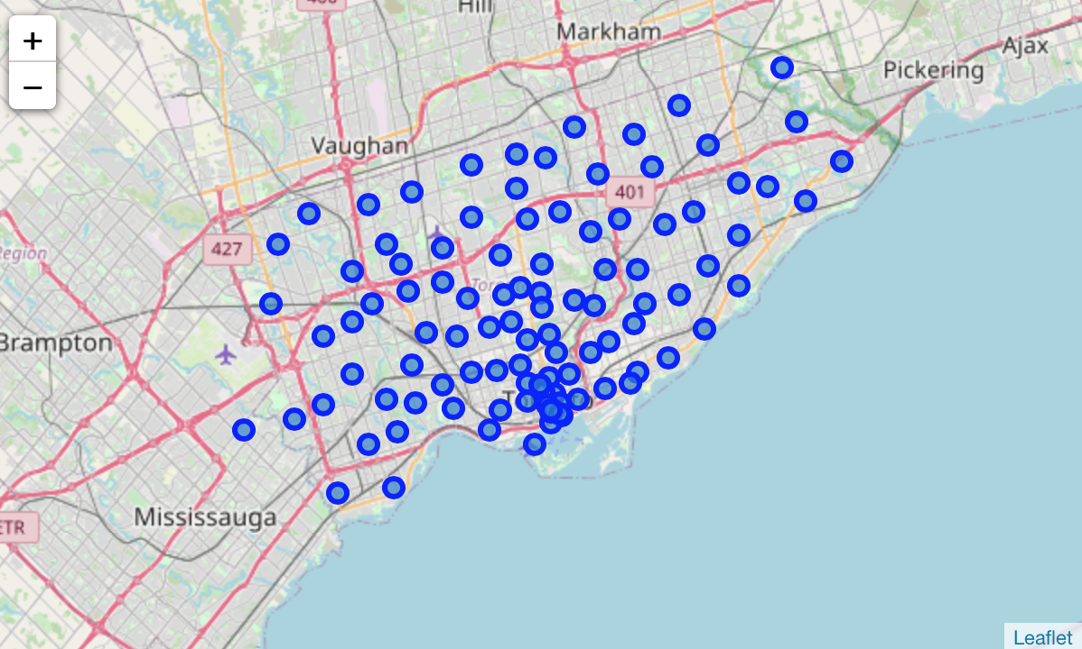
Results
After combining neighbourhood data and geocodes, a map of Downtown Toronto is included as below.

Slide 7
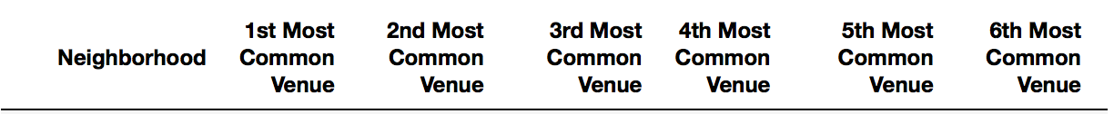
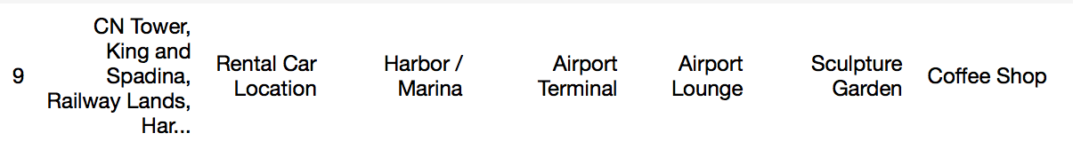
Top 5 most common venues for Central Bay Street and CN Tower is shown in the table below. More detailed results can be found in the notebook. We noticed for some neighbourhood e.g. Central Bay Street, it focuses more on lifestyle and entertainment. Most common venues includes coffee shops, cafes, restaurants, pizza place, as well as movie theatre and gallery. However CN Tower is more industrial which has more rental cars, harbour and airport related venues. On the other hand, Christie has more grocery stores, parks but also nightclub and gym.

Slide 8
Discussion
Each neighbourhood focuses on different factors. Some pays more attention to people’s lifestyle and some would be more industrial. For people who wants to live a more balanced lifestyle and the focus is on enjoying life, then Central Bay Street would be a better option. If people’s career requires lots of travelling then it might be a better idea to stay closer to the airport. However for families especially with teenagers, they might prefer Christie as it covers both grocery shopping and exercising.

Slide 9
Conclusion
Different factors of each neighbourhood can be obtained and evaluated, however it should be decided based on what matters the most to each individual.
When making a decision of which neighbourhood to stay in, one should look at the most common venues in that neighbourhood and determine if these are sufficient and matches with their needs.

